Slide 1
Building an Institutional-Grade
Equity Research Pipeline
Data Management for Cross-Sectional Asset Pricing
B. Kofi Owusu Sarfo
MIS 502 | Data Management for Analytics | WPI Business School
Spring 2026_DMA Report

Slide 2
Agenda
1
Dataset Overview
CRSP/Compustat via WRDS, 1.35M observations
2
Data Wrangling
Cleaning, feature engineering, 11 factors
3
Data Mining
Regression, classification, clustering, PCA
4
Visualizations
15 charts covering all required types
5
Portfolio & Risk
Markowitz optimization, Sharpe = 2.06
6
Conclusions
Key findings and implications

Slide 3
1. Dataset Overview
1,348,447
14,666
37
34 yrs
Firm-month
observations
Unique
securities
Raw
variables
Jan 1990 –
Dec 2023
CRSP Monthly Stock File: Returns, prices, shares outstanding for NYSE/AMEX/NASDAQ common stocks (shrcd 10,11)
Compustat Annual Fundamentals: Balance sheet and income statement (at, ceq, sale, ni, oibdp, capx)
Merge: CUSIP-8 backward asof join with 6-month availability lag (no look-ahead bias)
Source: WRDS (Wharton Research Data Services) - same infrastructure used by academic researchers and quantitative hedge funds

Slide 4
Data Quality & Ethics
Quality Checks
Ethics Considerations
✓ Zero duplicate firm-months
✓ Zero null adjusted returns
✓ Zero non-positive market equity
✓ Share codes validated (10, 11)
✓ Exchange codes validated (1, 2, 3)
176 extreme returns → winsorized
58,538 negative B/E → flagged
Survivorship bias: Delisting returns included
Data snooping: Temporal train/test split
Reproducibility: WRDS academic access
Privacy: Public financial data only
Market impact: Historical evidence, not guarantees
Exchange: NYSE 31.3% | AMEX 7.0% | NASDAQ 61.7% Missing: capx 8.2% (highest), most variables < 2%

Slide 5
2. Data Wrangling Pipeline
Step | Operation | Result
1–3 | Parse dates, remove duplicates, drop null returns | 1,348,447 rows (no removals)
4 | Remove penny stocks (|price| < $1.00) | 36,163 removed → 1,312,284
5 | Winsorize returns (0.5th/99.5th pctl) | Extreme outliers clipped
6 | Engineer 11 factors + 6 accounting ratios | 37 → 65 columns
7 | Winsorize ratios (1st/99th pctl per month) | Cross-sectional cleaning
Before
After
1,348,447 rows × 37 columns
1,312,284 rows × 65 columns
Raw CRSP/Compustat merge output
2.68% removed | 28 new features added

Slide 6
11 Engineered Cross-Sectional Factors
Factor | Formula | Coverage
Momentum | Cumulative ret t-12 to t-2 | 88.5%
Reversal | Prior month return | 98.9%
Size | log(lagged market equity) | 98.9%
Value (B/M) | book_equity / lagged ME | 97.7%
Profitability | oibdp / total assets | 97.7%
Investment | capx / total assets | 91.7%
Leverage | (dltt + dlc) / total assets | 98.7%
E/P | net income / lagged ME | 97.5%
Beta | 60-month rolling CAPM (mean=1.065) | 67.9%
Volatility | 12-month rolling std dev | 94.6%
Size Quintile | NYSE breakpoints, all stocks assigned | —

Slide 7
3a. Regression - Return Prediction
Out-of-sample: Jan 2016 – Nov 2023 (216,744 obs) | Train: Jul 1993 – Dec 2015 (606,584 obs)
Model | OOS R² | Hit Rate | L/S Spread | t-stat
Ridge | 0.37% | 53.76% | 1.17%/mo | 2.48
Lasso | 0.58% | 53.74% | 1.26%/mo | 2.56
Random Forest | 0.54% | 53.76% | 1.44%/mo | 3.88
XGBoost | 0.30% | 53.11% | 1.43%/mo | 4.38
Key insight: All models produce statistically significant long/short spreads (t > 2.0). Non-linear models (RF, XGBoost) achieve stronger economic results (1.43–1.44%/mo) vs. linear models (1.17–1.26%), suggesting factor interactions carry additional predictive information.

Slide 8
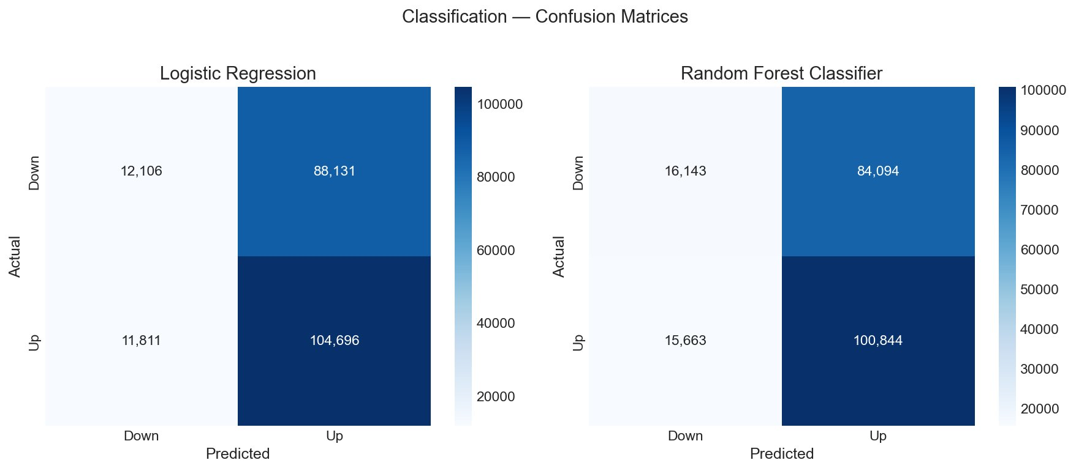
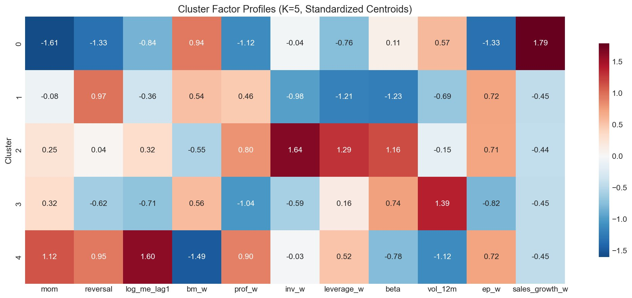
3b. Classification & Clustering
Classification (Up/Down)
K-Means Clustering (K=5)
Logistic Regression: 53.89% accuracy
RF Classifier: 53.97% accuracy
Both above 50% random baseline
Strong at predicting “up” (89% recall)
Weak at predicting “down” (16% recall)
5 firm archetypes identified:
C0 (17): Distressed turnaround firms
C1 (734): High-beta, high-leverage
C2 (523): Capital-intensive industrials
C3 (251): Unprofitable, speculative
C4 (914): Blue-chip growth (largest)

Slide 9
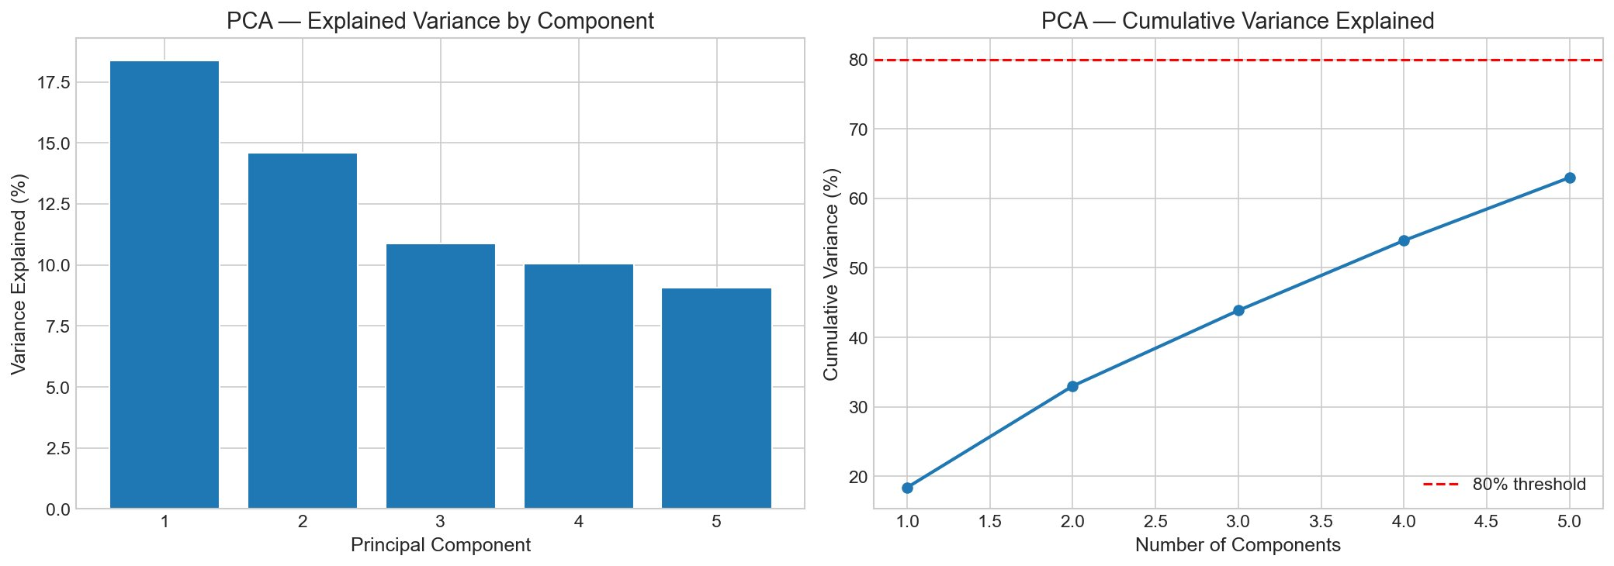
3c. PCA & Correlation Analysis
Top Factor Correlations
Beta × Volatility: +0.385
Size × Value: −0.379
Profitability × E/P: +0.378
Max correlation < 0.4 →
Factors are not redundant
PCA: 5 components capture 63% of variance. No single component dominates (max 18.4%), confirming 11 factors capture multiple independent risk dimensions. Text mining: not applicable — dataset contains only structured numerical/categorical data.

Slide 10
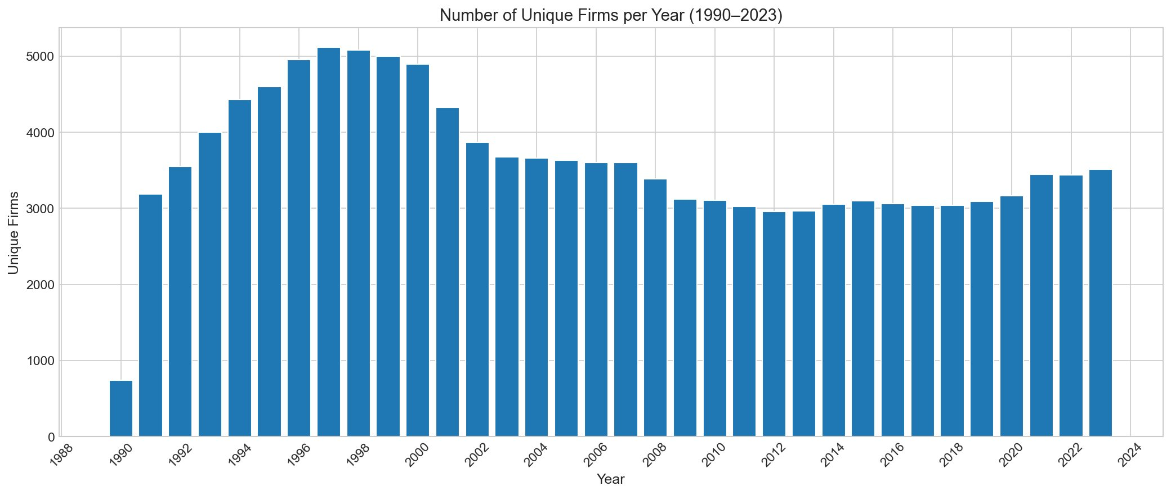
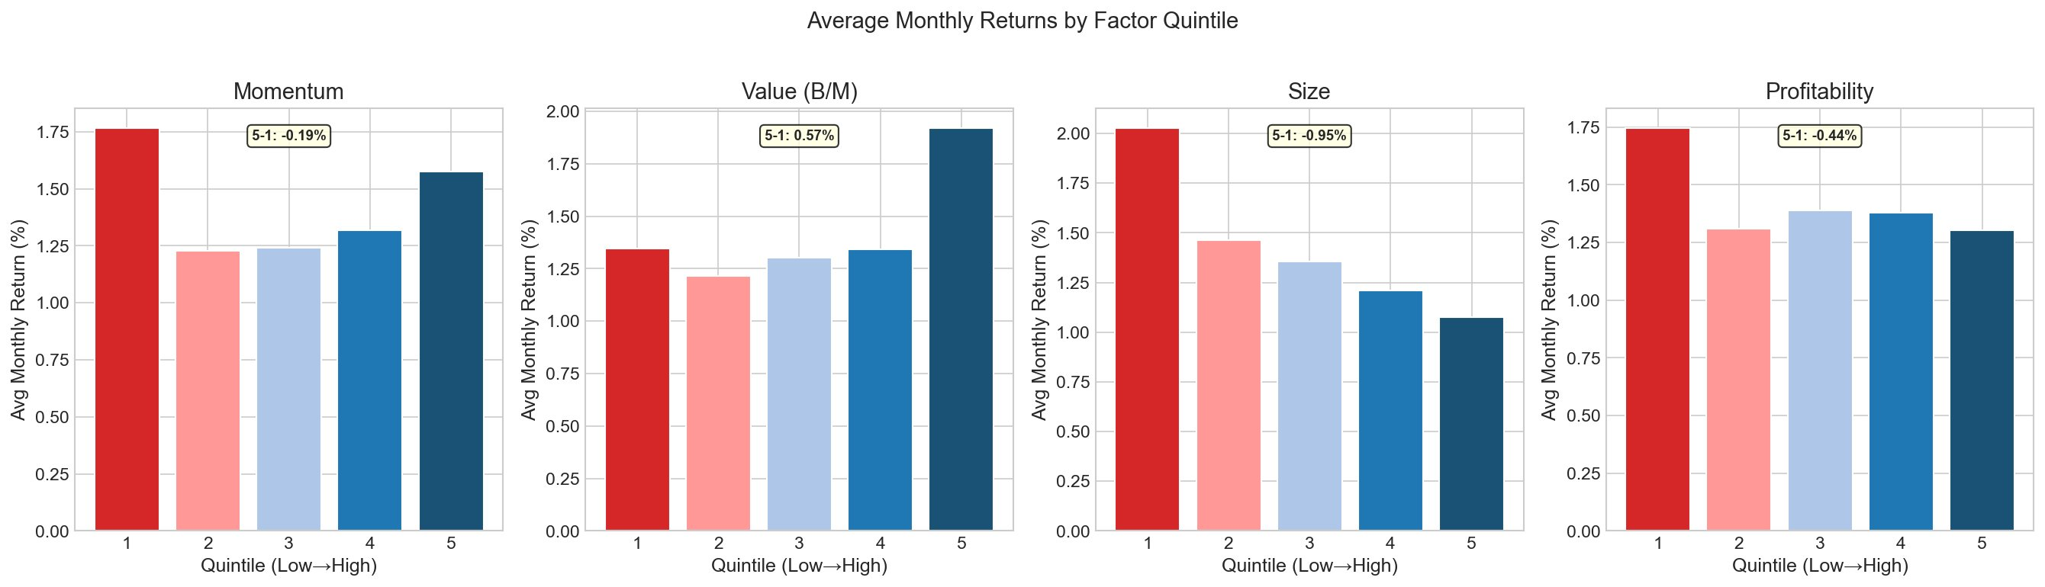
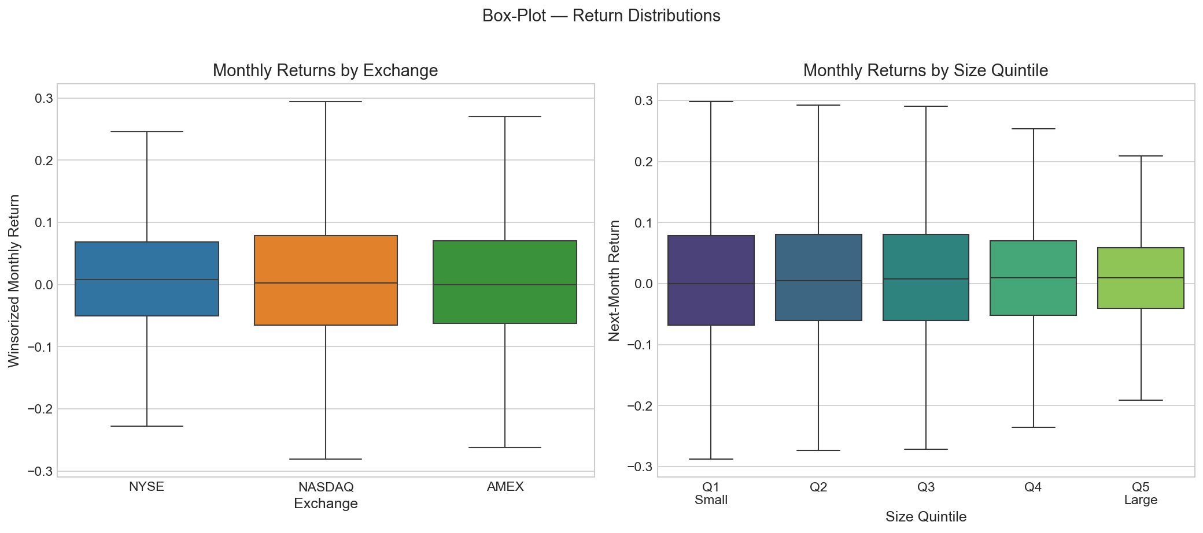
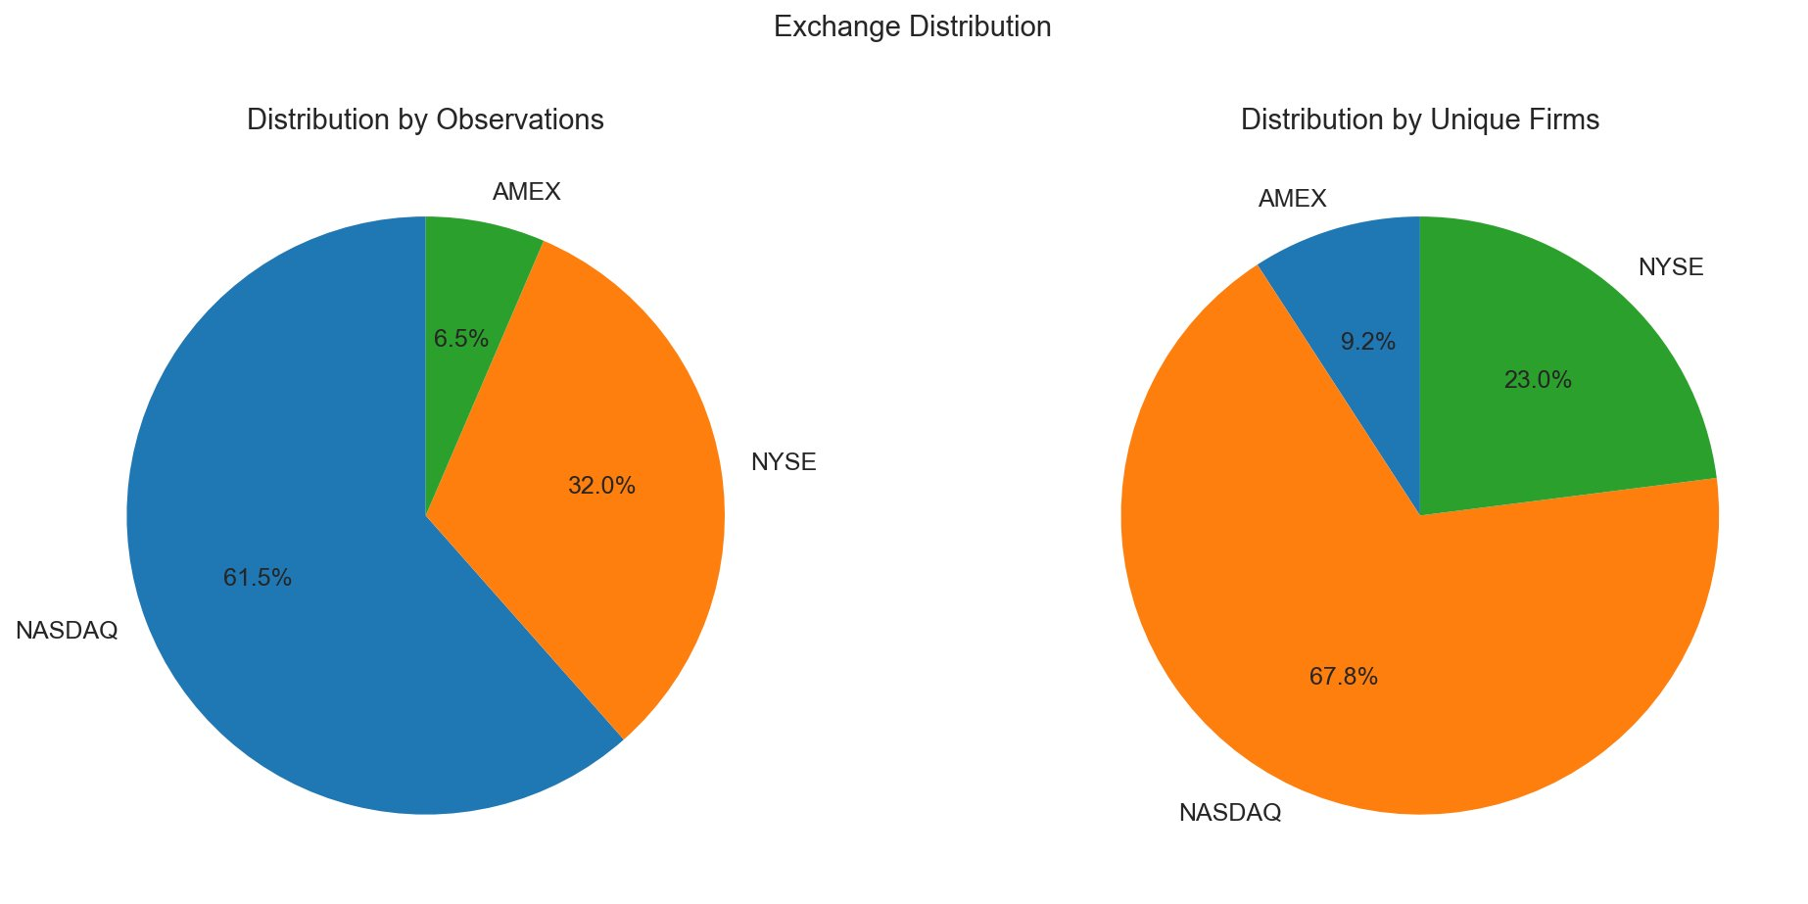
4. Data Visualizations

Slide 11
5. Portfolio Construction & Risk
2.06
19.2%
7.15%
55
Sharpe
Ratio
Annual
Return
Annual
Volatility
Stock
Positions
Top Holdings: SO (5.0%), DLTR (5.0%), CLX (4.9%), GIS (4.5%), EW (4.1%), MO (4.0%)
Portfolio tilts toward defensive/consumer staples (max-Sharpe favors steady returns) with high-momentum growth names (TSLA, NFLX).
Risk: 73.8% turnover vs equal-weight | 7.4 bps estimated transaction cost | Top 5 = 23.5% | Effective positions = 36

Slide 12
6. Conclusions
Factor prediction is real
All 4 models produce significant L/S spreads (t = 2.48–4.38) over 8-year OOS period
Non-linear models add value
RF/XGBoost achieve 1.43–1.44%/mo spread vs 1.17–1.26% for linear models
Multi-dimensional risk
PCA confirms 5 independent factor dimensions (63% variance) — no redundancy
Firm archetypes exist
K-Means identifies 5 interpretable clusters from blue-chip growth to distressed turnaround
Strong portfolio outcomes
Markowitz optimizer delivers Sharpe = 2.06, 19.2% annual return, 55-stock diversification

Slide 13
Thank You
Questions?
MIS 502 | Managing Data for Analytics
WPI Business School | Spring 2026

